Slide 1
Game Development with Unity
Abdullah Hamed Senior Program Manager – Game Dev Tools (DevDiv)
Sarah Sexton
Software Engineer – Spatial Computing Dev Crew (CSE)

Slide 2

What are we covering?
Intro to Unity
What are the updates to Unity support in Visual Studio for Mac

Slide 3
Game Engine
High Level APIs (Graphics, Input, Networking, Audio… etc)
Visual Tools and Editor
C# and Visual Studio and Visual Studio for Mac
Notes:
Unity is a game engine; you can think about it as set of high level APIs relevant to game developers that takes all the heavy lifting from game programming.
Graphics, networking, input, and everything related to game development.
It also includes visual editing tools. Not everyone working on games is a programmer you know. With unity, you can you C# to script behaviors.

Slide 4
Demo
Notes:
Use platformer microgame demo, turn off audio
1- Scene and Heirarchy - Tools pan and zoom – select from the heirarchy - Game view – files and assets
2- inspector - edit properties – choose player – edit max speed – play mode
3- build – build settings – switch platforms
Making a script from scratch
1- open VSM, create script
2- rename – show Unity messages that can be used
3- create some public variables – Public int,GameObject, RigidBody, transform
4- attach it to game object, show how it appears in the editor.

Slide 5
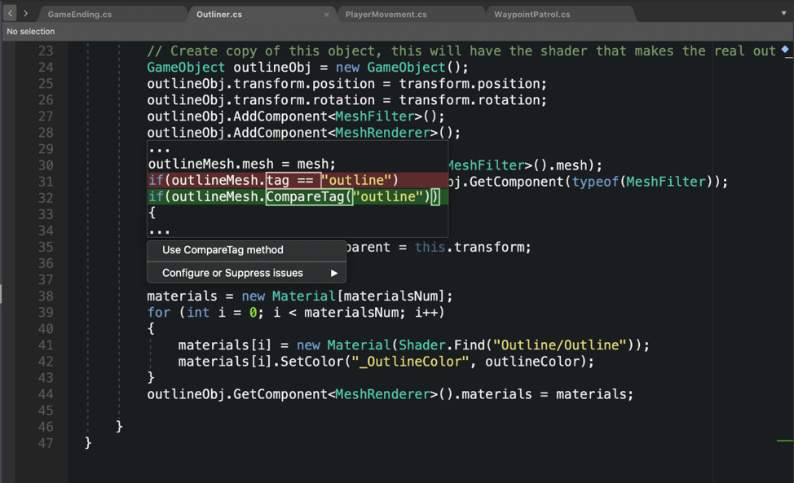
What’s new?
The Roslyn Analyzer is now open source
Notes:
VS and VSM rely on Roslyn, our compiler infrastructure, to deliver a fantastic C# programming experience.
One of my favorite features of Roslyn is the ability to programmatically guide developers when using an API. At the core of this experience, an analyzer detects a code pattern, and can offer to replace it with a more recommended pattern.
collision.gameObject.tag == "enemy"; -> collision.gameObject.CompareTag("enemy");

Slide 6
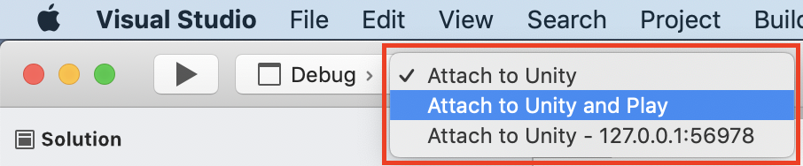
What’s new?
Attaching the IDE Debugger to any Unity instance
Notes:
Use the platformer microgame and build the game for Android then attack it to your android phone.

Slide 7
What’s new?
Added support for automatically refreshing Unity’s asset database on save
Unity project don’t need to fully build anymore
The same Windows Unity Debugger in Visual Studio for Mac
Shader highlighting
Pointer support in the debugger

